Slide 1


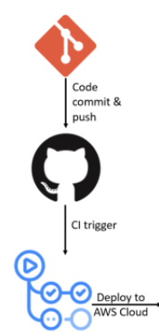










ACS730_Fall 2024_Final Project Architecture Diagram
SSH
1
2
AWS US East 1
SSH
SSH
Internet gateway
VPC Prod
1
2
3
4
SSH, HTTP
SSH, HTTP
SSH, HTTP
SSH, HTTP
Load Balancer
Availability Zone – 1a
8
Availability Zone – 1b
Availability Zone – 1c
Availability Zone – 1d
Public subnet 1
CIDR: 10.1.1.0/24
Public subnet 2
CIDR: 10.1.2.0/24
Public subnet 3
CIDR: 10.1.3.0/24
Public subnet 3
CIDR: 10.1.4.0/24
Auto Scaling group
WebServer1
Bastion VM
Webserver2
Webserver3
Webserver4
NAT gateway
SSH
5
SSH
6
7
Private subnet 1
CIDR: 10.1.5.0/24
Private subnet 2
CIDR: 10.1.6.0/24
Webserver 5
VM6

